Slide 1
PENGANTAR ALGORITME DECISION TREE
Joko Suntoro
joko@jokosuntoro.com
SMS/Telp: 0822-4236-9670
WA/Telegram: 085-641-970-170
http://jokosuntoro.com

Slide 2

Joko Suntoro
SDN Pandean Lamper 03 Semarang (2001)
SMPN 32 Semarang (2004)
SMA Institut Indonesia Semarang (2007)
S1 Teknik Informatika Universitas Semarang (2010-2015)
S2 Teknik Informatika Universitas Dian Nuswantoro (2015-2016)
Tim Operasi dan Teknik, Domestic Gas PT Pertamina (Persero) (2008-sekarang)
Dosen dan Peneliti di Fakultas Teknologi Informasi dan Komunikasi Universitas Semarang
Peneliti dan Reviewer di Romi Satria Wahono (RSW) Intelligent System Research Group
Bidang Penelitian: Data Mining, Intelligent System dan Machine Learning

Slide 3
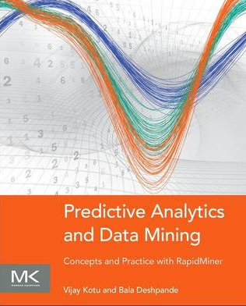
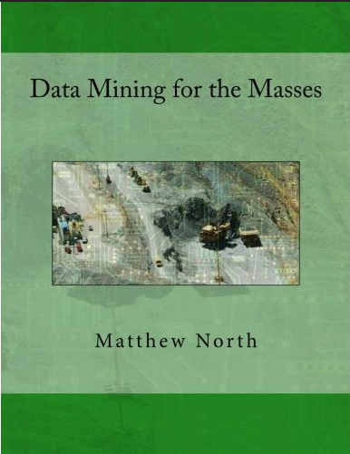
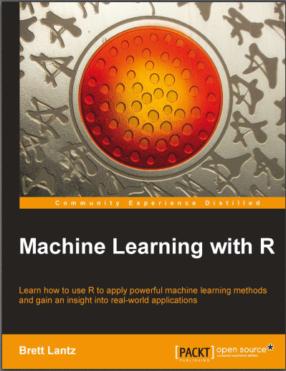
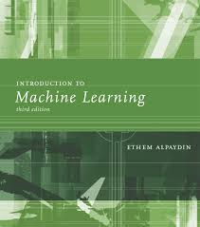
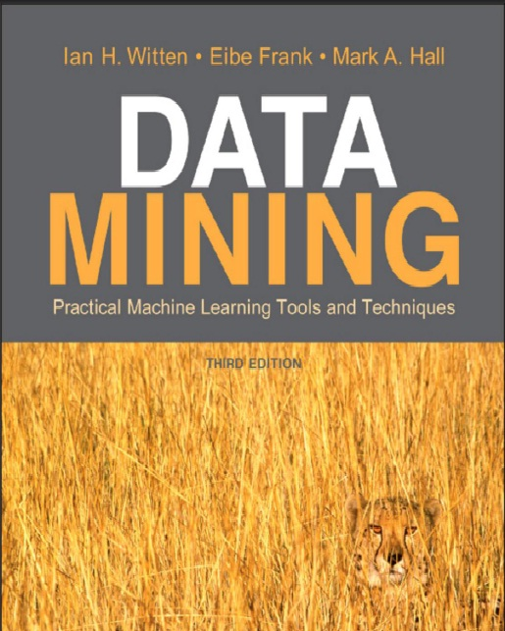
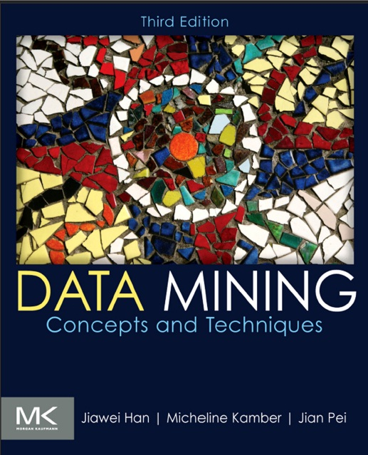
Textbooks

Slide 4
Definisi Algoritme Decision Tree
Algoritme Decission Tree adalah suatu metode Algoritme dengan mengkonstruksi pohon keputusan dari sebuah dataset training yang berupa record-record dalam basis data (Larose, 2005).

Slide 5
Jenis Algoritme Decision Tree
Algoritme
Decision Tree
ID3
(Iterative Dichotomiser 3)
C4.5
CART
(Classification and Regression Trees)

Slide 6
ALGORITME C4.5

Slide 7
Tahapan Algoritme C4.5
1. Menyiapkan dataset
2. Hitung nilai entropy
7. Ulangi proses untuk setiap cabang hingga semua node terpartisi
3. Hitung nilai gain
6. Buat cabang untuk tiap-tiap nilai
4. Hitung nilai split info
5. Hitung nilai gain ratio

Slide 8
Tahapan Algoritme C4.5
Menyiapkan dataset
Age | Income | Student | Credit Rating | Buys_Computer
youth | high | no | fair | no
youth | high | no | excellent | no
middle_aged | high | no | fair | yes
senior | medium | no | fair | yes
senior | low | yes | fair | yes
senior | low | yes | excellent | no
middle_aged | low | yes | excellent | yes
youth | medium | no | fair | no
youth | low | yes | fair | yes
senior | medium | yes | fair | yes
youth | medium | yes | excellent | yes
middle_aged | medium | no | excellent | yes
middle_aged | high | yes | fair | yes
senior | medium | no | excellent | no

Slide 9
Tahapan Algoritme C4.5
Hitung Nilai Entropy
Keterangan:
S = himpunan kasus
n = jumlah partisi S
pi = proposi Si terhadap S

Slide 10
Tahapan Algoritme C4.5
Hitung Nilai Entropy
Node | Atribut | Value | Jumlah Kasus | Yes | No | Entropy
1 | TOTAL |  | 14 | 9 | 5 | 0,940
 | Age
 |  | youth | 5 | 2 | 3 | 0,971
 |  | middle_aged | 4 | 4 | 0 | -
 |  | senior | 5 | 3 | 2 | 0,971
 | Income
 |  | low | 4 | 3 | 1 | 0,811
 |  | medium | 6 | 4 | 2 | 0,918
 |  | high | 4 | 2 | 2 | 1,000
 | Student
 |  | yes | 7 | 6 | 1 | 0,592
 |  | no | 7 | 3 | 4 | 0,985
 | Credit Rating
 |  | fair | 8 | 6 | 2 | 0,811
 |  | excellent | 6 | 3 | 3 | 1,000

Slide 11
Tahapan Algoritme C4.5
Hitung Nilai Gain
Keterangan:
S = himpunan kasus
A = fitur
n = jumlah partisi atribut A
|Si| = proporsi Si terhadap S
|S| = jumlah kasus dalam S

Slide 12
Tahapan Algoritme C4.5
Hitung Nilai Gain
Node | Atribut | Value | Jumlah Kasus | Yes | No | Entropy | Gain
1 | TOTAL |  | 14 | 9 | 5 | 0,940
 | Age |  |  |  |  |  | 0,247
 |  | youth | 5 | 2 | 3 | 0,971
 |  | middle_aged | 4 | 4 | 0 | -
 |  | senior | 5 | 3 | 2 | 0,971
 | Income |  |  |  |  |  | 0,029
 |  | low | 4 | 3 | 1 | 0,811
 |  | medium | 6 | 4 | 2 | 0,918
 |  | high | 4 | 2 | 2 | 1,000
 | Student |  |  |  |  |  | 0,152
 |  | yes | 7 | 6 | 1 | 0,592
 |  | no | 7 | 3 | 4 | 0,985
 | Credit Rating |  |  |  |  |  | 0,048
 |  | fair | 8 | 6 | 2 | 0,811
 |  | excellent | 6 | 3 | 3 | 1,000

Slide 13
Tahapan Algoritme C4.5
Hitung Nilai Split Info

Slide 14
Tahapan Algoritme C4.5
Hitung Nilai Split Info
Node | Atribut | Value | Jumlah Kasus | Yes | No | Entropy | Gain | Split Info
1 | TOTAL |  | 14 | 9 | 5 | 0,940
 | Age |  |  |  |  |  | 0,247 | 1,577
 |  | youth | 5 | 2 | 3 | 0,971
 |  | middle_aged | 4 | 4 | 0 | -
 |  | senior | 5 | 3 | 2 | 0,971
 | Income |  |  |  |  |  | 0,029 | 1,557
 |  | low | 4 | 3 | 1 | 0,811
 |  | medium | 6 | 4 | 2 | 0,918
 |  | high | 4 | 2 | 2 | 1,000
 | Student |  |  |  |  |  | 0,152 | 1,000
 |  | yes | 7 | 6 | 1 | 0,592
 |  | no | 7 | 3 | 4 | 0,985
 | Credit Rating |  |  |  |  |  | 0,048 | 0,985
 |  | fair | 8 | 6 | 2 | 0,811
 |  | excellent | 6 | 3 | 3 | 1,000

Slide 15
Tahapan Algoritme C4.5
Hitung Nilai Gain Ratio

Slide 16
Tahapan Algoritme C4.5
Hitung Nilai Gain Ratio
Node | Atribut | Value | Jumlah Kasus | Yes | No | Entropy | Gain | Split Info | Gain Ratio
1 | TOTAL |  | 14 | 9 | 5 | 0,940
 | Age |  |  |  |  |  | 0,247 | 1,577 | 0,156
 |  | youth | 5 | 2 | 3 | 0,971
 |  | middle_aged | 4 | 4 | 0 | -
 |  | senior | 5 | 3 | 2 | 0,971
 | Income |  |  |  |  |  | 0,029 | 1,557 | 0,019
 |  | low | 4 | 3 | 1 | 0,811
 |  | medium | 6 | 4 | 2 | 0,918
 |  | high | 4 | 2 | 2 | 1,000
 | Student |  |  |  |  |  | 0,152 | 1,000 | 0,152
 |  | yes | 7 | 6 | 1 | 0,592
 |  | no | 7 | 3 | 4 | 0,985
 | Credit Rating |  |  |  |  |  | 0,048 | 0,985 | 0,049
 |  | fair | 8 | 6 | 2 | 0,811
 |  | excellent | 6 | 3 | 3 | 1,000

Slide 17
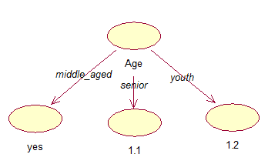
Tahapan Algoritme C4.5
Buat cabang untuk tiap-tiap nilai

Slide 18
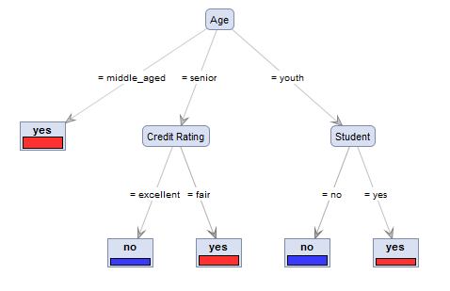
Tahapan Algoritme C4.5
Ulangi proses untuk setiap cabang hingga semua node terpartisi

Slide 19
Penghitungan Manual
Penghitungan manual akan saya jelaskan di kelas, saat mata kuliah data mining

Slide 20
Referensi
Bache, K., & Lichman, M. (2013). UCI Machine Learning Repository. Retrieved from http://www.ics.uci.edu/~mlearn/MLRepository.html
Ethem Alpaydin. Introduction to Machine Learning. 3rd ed. MIT Press. 2014
Harrington, P. (2012). Machine Learning in Action. United States of America: Manning Publications Co.
Hofmann, M., & Klinkenberg, R. (2013). Rapid Miner Data Mining Use Cases and Business Analytics Applications. CRC Press Taylor & Francis Group
Ian H. Witten, Frank Eibe, Mark A. Hall. Data mining: Practical Machine Learning Tools and Techniques 3rd Edition. Elsevier. 2011
Jiawei Han and Micheline Kamber. Data Mining: Concepts and Techniques Third Edition. Elsevier. 2012
Lantz, Brett. Machine Learning with R. Packt Publishing. 2013
Larose, D. T. (2006). Data Mining Methods and Models. Data Mining Methods and Models. Canada: Willey Publishing, Inc.
Noth, Matthew. Data Mining for The Masses. Creative Commons Attribution. 2012
V. Kotu, Predictive analytics and data mining. USA: Elsevier Inc., 2015.
Wahono, R. S. (2016). Computing Courses Data Mining. Retrieved from http://romisatriawahono.net/dm/

